Slide 1

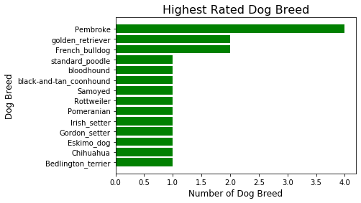
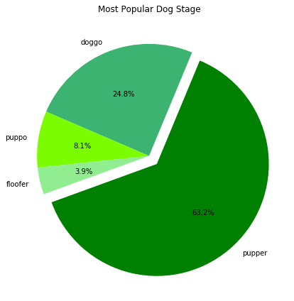
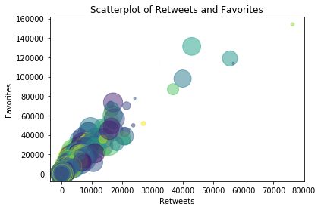
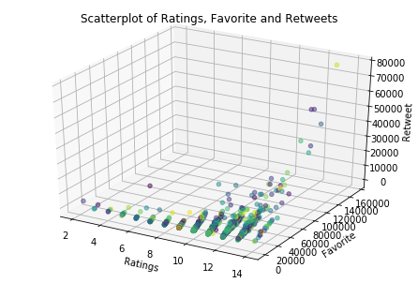
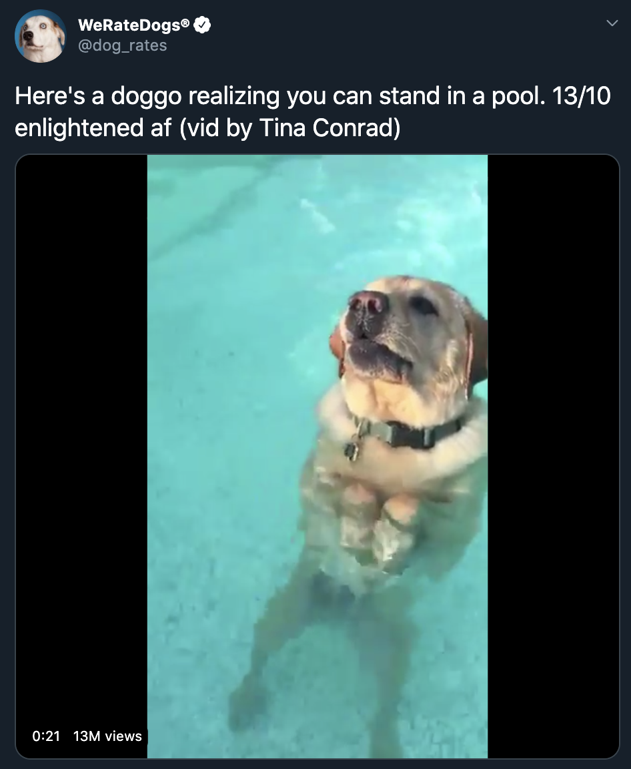
Dog’s Hall of Fame- An Analysis of tweets from @dogrates
Standing in the hall of fame is a goal many have – doubt me, ask your favorite celebrity. It is only fair that man’s best friend dogs are not left out. Twitter user- @dog_rates, also kn_own as WeRateDogs is dedicated to rating people’s dog with humorous comment about the dog. These ratings almost always have a denominator of 10. The numerators, though? Almost always greater than 10. 11/10, 12/10, 13/10, etc. Why? Because "they're good dogs Brent.”
This post shares insights generated from an analyses of data wrangled from @dog_rates Twitter archive, a file with predicted breed and querying Twitter’s API.
The Dataset: includes 1,568 original tweets (excluding retweets and non-dog rates) posted between November 15, 2015 and August 1, 2017. In terms of dog stage, it includes 63.2% pupper, 24.8% doggy, 8.1% puppo and 3.9% are floffer (Fig 1). Overall, the tweets rated 111 unique breeds of dogs. The top 10 most popular breed (by number of posts- Fig 2) were Golden Retriever (134), Labrador Retriever (89), Pembroke (88), Chihuahua (78), Pug (54), Chow (41), Samoyed (39), Pomeranian (38), Toy Poodle (36) and Malamute (29) .
Fig 1
Fig 2
Most Rated: Dog rating ranged from 2 (for Crystal- a Maltese dog) to 14 (in 24 dogs). The most rated (rating = 14) dog species is Pembroke, closely followed by the Golden Retriever and French BullDog.
Most Retweeted: The Most Retweeted Dog goes to a Labrador Retriever that realized ‘you can stand in a pool’. The tweet which includes a video garnered 76,281 retweets! This was 19,547 retweets more than the second most retweeted tweet – which showed a video of an Eskimo dog blowing bubbles in a bowl water and tweeted 14 days before.
Four-fifth (4/5) of the most retweeted @dog_rates tweets were videos of dogs participating in 'fun' activities out of which two-fifth (2/5) involved water. If you are aiming for Most Retweeted, be an aquaphile and don’t forget to make a video while at it!
Most Favorite: The top 5 most favorited tweets includes 4 of the most 5 retweeted dogs. This confirms the strong positive correlation- Fig 3 (that is- as favorite increases, retweets increases) between favorite and retweet as indicated by the bivariate scatterplot.
The Most Retweeted maintains a first place with 153,995 favorites (22,677 more favorites over the second position!).
Fig 3
Fig 4
Least Retweeted and Least Favorite: ‘An Adobe Setter giving birth to twins’ was the least retweeted (11 retweets) and least favorited (70 favorite). A further review shows that the post was made when @dog_rates was relatively new with few users/reach.
Bringing it all together - rating, retweets and favorite
As strongly indicated in the Fig 4, the unnamed Labrador Retriever is the Most Voted Player this season (Fig 5). All stand for a doggo that achieved a feat only the brave dare- stands comfortable in water.
Fig 5: Overall Champion

